Slide 1
HTTP
Dr.Mohammed Abdalla Mahmoud Youssif
Network Programming
Beni-Suef University - Faculty of Computers and Artificial Intelligence

Slide 2
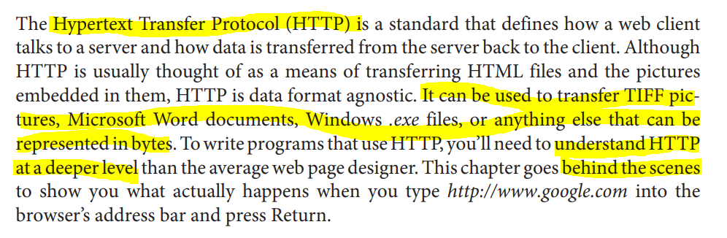
Overview

Slide 3
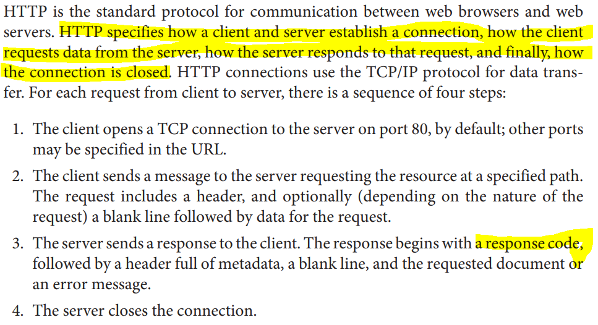
The Protocol

Slide 4
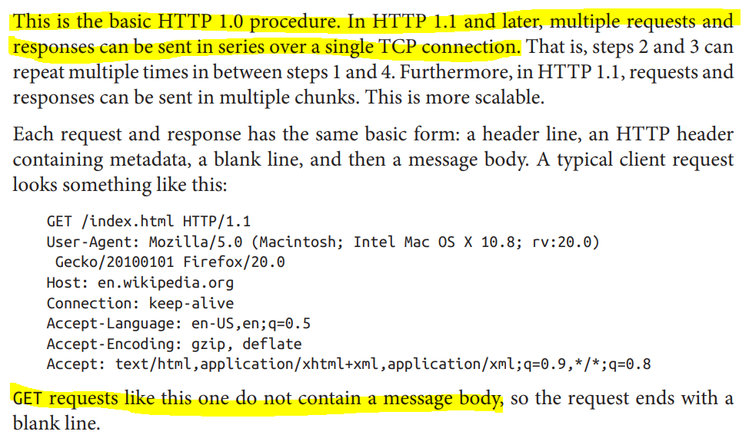
The Protocol

Slide 5
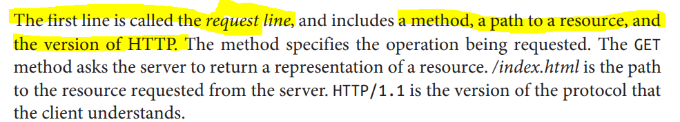
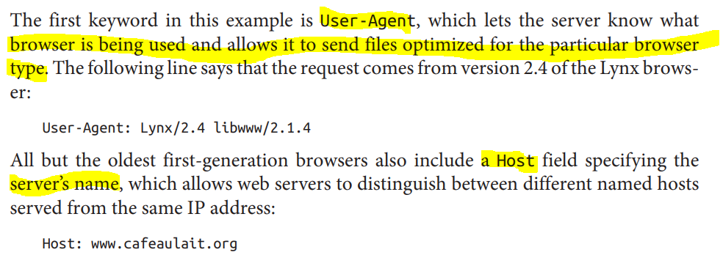
The Protocol

Slide 6
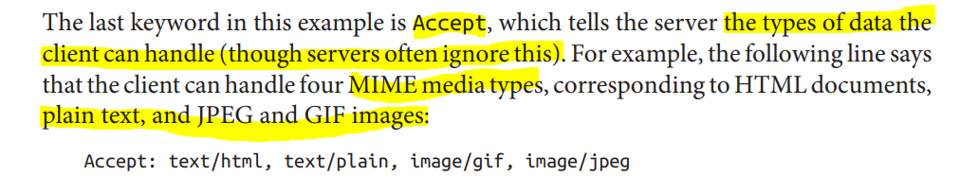
The Protocol

Slide 7
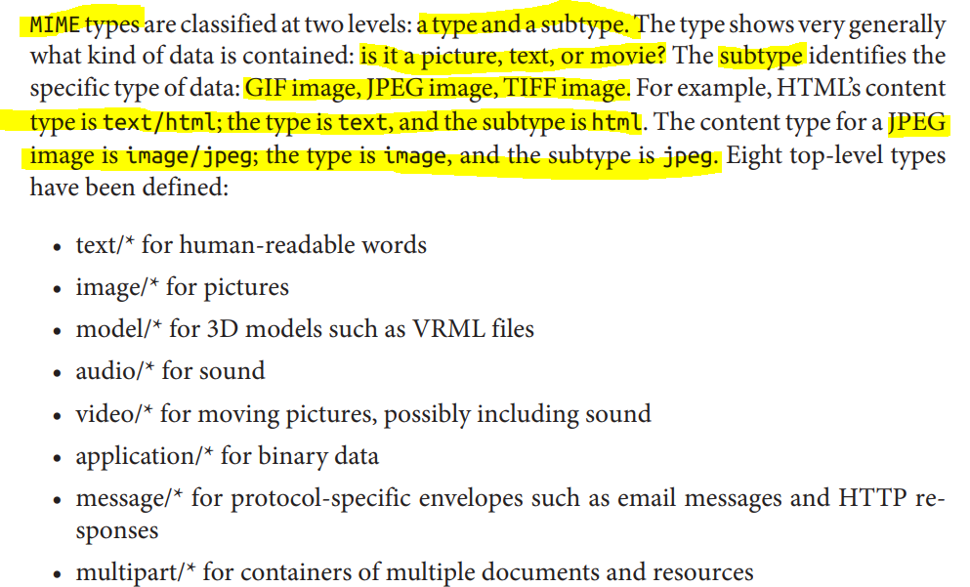
The Protocol

Slide 8
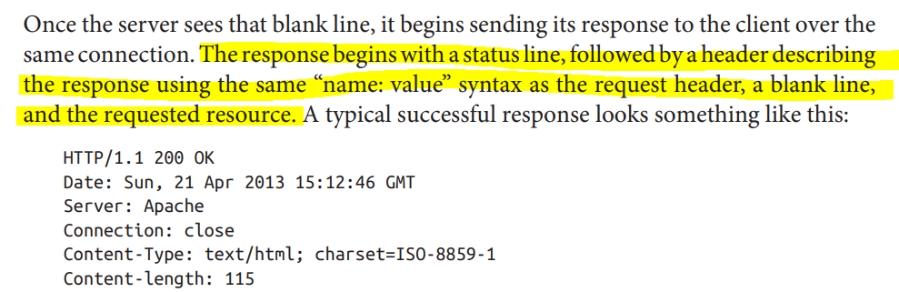
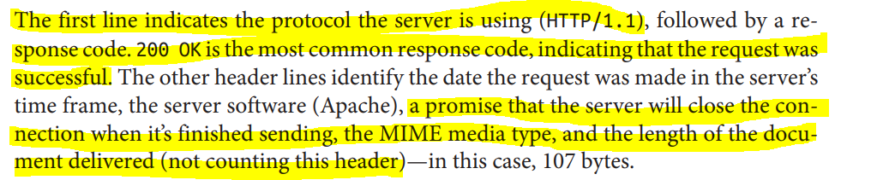
The Protocol

Slide 9
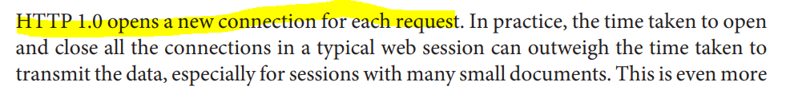
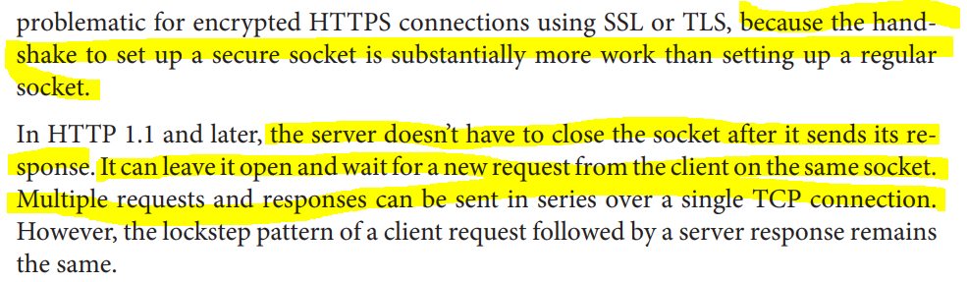
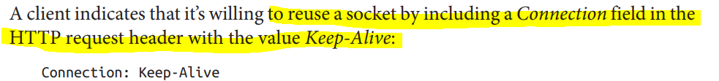
Keep-Alive
Notes:
abandoned مهجور

Slide 10
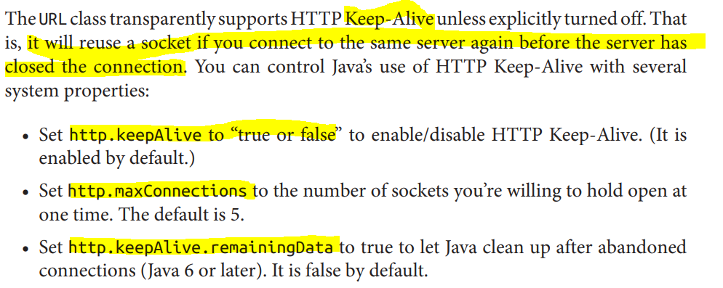
Keep-Alive
Notes:
abandoned مهجور

Slide 11
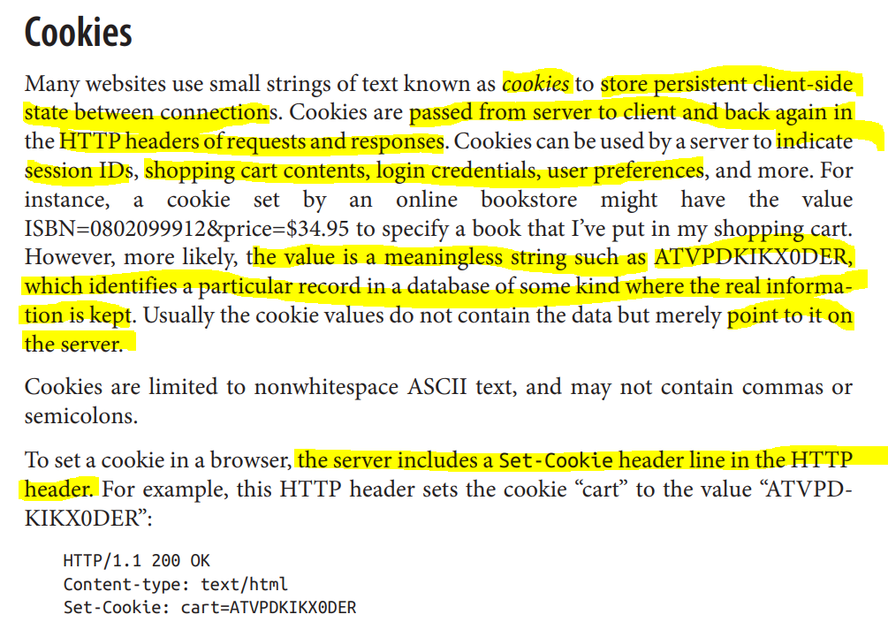
Notes:
abandoned مهجور

Slide 12
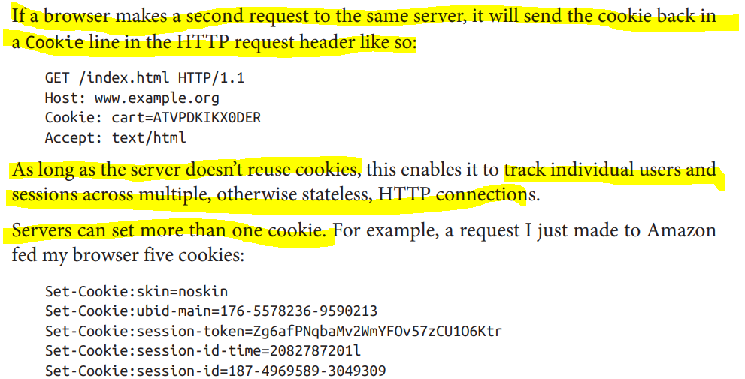
Cookies
Notes:
abandoned مهجور

Slide 13
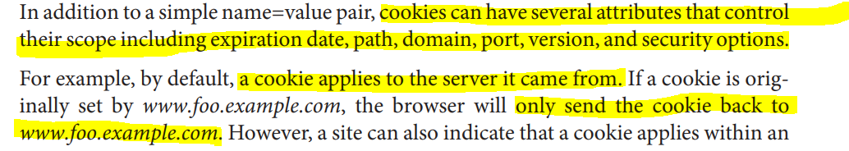
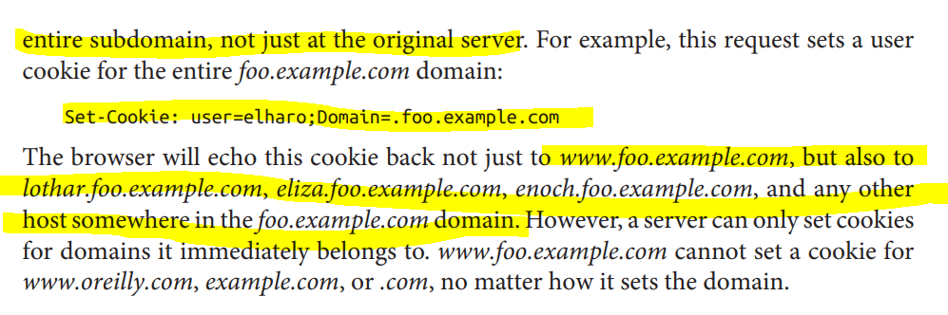
Cookies
Notes:
abandoned مهجور

Slide 14
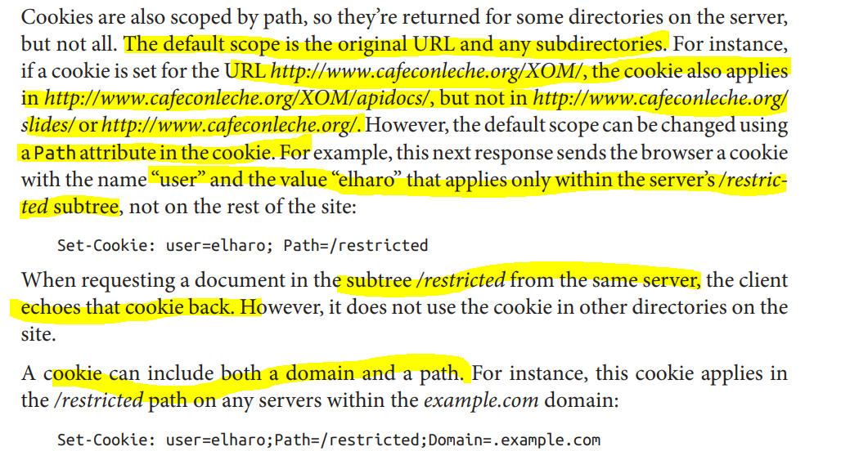
Cookies
Notes:
abandoned مهجور

Slide 15
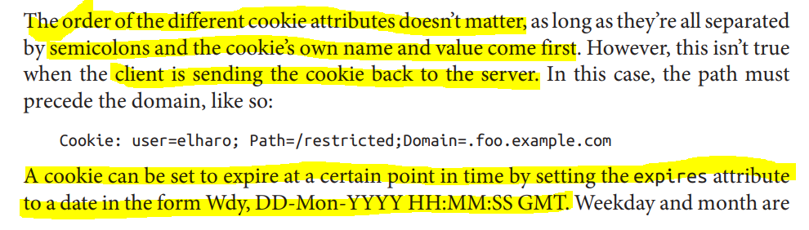
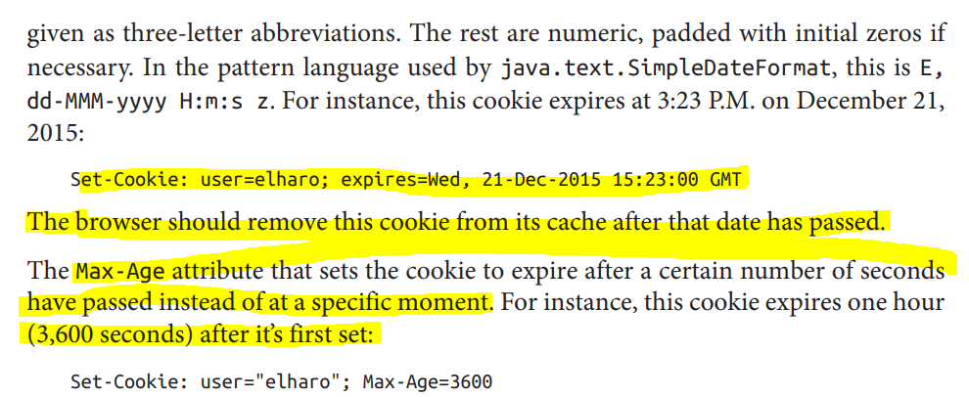
Cookies
Notes:
abandoned مهجور

Slide 16
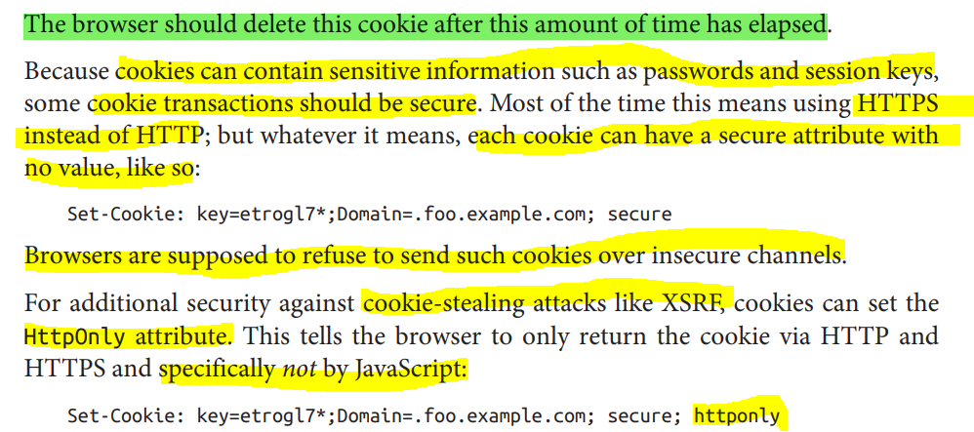
Cookies
Notes:
abandoned مهجور

Slide 17
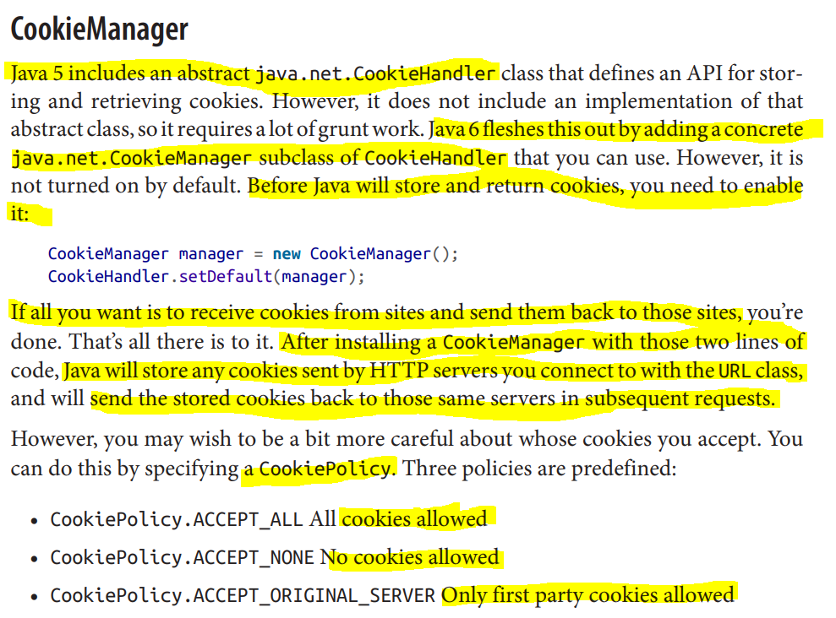
Notes:
abandoned مهجور
For example, this code fragment tells Java to block third-party cookies but accept firstparty cookies: CookieManager manager = new CookieManager(); manager.setCookiePolicy(CookiePolicy.ACCEPT_ORIGINAL_SERVER); CookieHandler.setDefault(manager); That is, it will only accept cookies for the server that you’re talking to, not for any server on the Internet

Slide 18
